Slide 1
Phil 271 Spring 2017
Lecture 2

Slide 2
AccessAbility Services Volunteer Notetaker Required
Interested? Complete an online application using your WATIAM:
https://york.accessiblelearning.com/UWaterloo/
More information:
Website: https://uwaterloo.ca/accessability- services/current-students/notetaking-services
Email: notetaking@uwaterloo.ca
Phone: 519-888-4567, ext. 35082

Slide 3
What we want to cover today
We’re going to “look at” Plato, Aristotle, and Euclid. The goal is not just to have a picture of what their views were about mathematics, but also:
Extract ideas these philosophers advanced that will show up repeatedly during the term
Try to have some idea of why someone might accept some of these views, which at first might seem rather outlandish
Set the table for later discussions about how mathematics influences philosophy

Slide 4
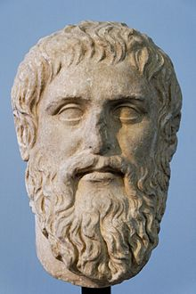
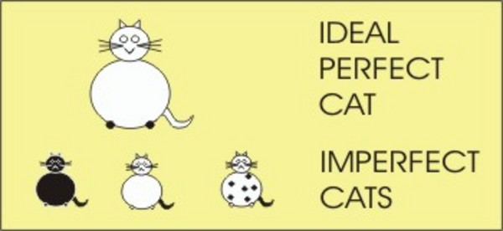
Plato: the theory of forms

Slide 5
Important terminology: Ontology and Epistemology
Ontology:
“the branch of metaphysics that studies the nature of existence or being as such” (Oxford Online Dictionary)
(Gee, thanks, that really clears things up.)
The branch of philosophy (or other disciplines) that studies questions about what the fundamental categories of existence are, how they are related, and what kinds of things fall within those categories.
Epistemology:
As my first philosophy instructor said: “Epistemology” is a $10 word for “theory of knowledge”
What do/can we know, and how do/can we know it?

Slide 6
Forms and the Physical
The forms:
For centuries, the standard translation was Ideas, rather than Forms
Once it became more standard to think of ideas as inhabitants of individual minds, the old translation became misleading
The forms are eternal, unchanging, and they exist independently of physical reality
Independently? For instance, there could be a form that is never “instantiated”
Physical objects, actions, institutions, etc., have properties when they “participate in” (“resemble”, “instantiate”, the terminology varies) the relevant form.

Slide 7
Why would anyone ever believe that?
One version, specifically for mathematical objects (which may or may not be actual “forms” for Plato, but are close enough to being forms for our purposes)
Mathematical claims are clearly true or false (this is what Shapiro calls “realism about truth values” for mathematics)
Every true statement needs a truthmaker … it is true because something makes it true.
The truthmakers for mathematical claims cannot be physical things (E.g., “A line tangent to a circle meets it at exactly one point” … not true of physical circles and lines.)
The truthmakers for mathematical claims must have the properties mathematics says they have (or else the claims wouldn’t be true)
So,
The mathematical objects must be non-physical

Slide 8
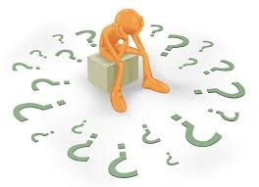
What about epistemology?

Slide 9
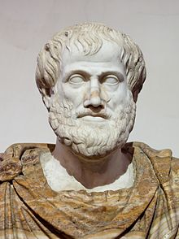
Aristotle
As we will see, there are many contemporary philosophers of math who are called “platonists,” and pretty much none who call themselves “aristoteleans.”
Nevertheless, some key ideas that go back to Aristotle are still knocking around.

Slide 10
Aristotle’s Forms
Hylomorphism is a central feature of Aristotle’s philosophy … every physical object is a combination of matter and form
So he obviously believed in forms in some sense---But these are not Plato’s forms anymore
No “realm of forms”: Aristotle’s forms exist “in the objects” of which they are forms
So it makes no sense to talk of a form existing “uninstantiated”

Slide 11
Mathematical objects?
Like pretty much everything about Aristotle, there are competing views about how to interpret what Aristotle says about the things we appear to be talking about when we talk about mathematics …
Mathematical objects exist, and are the product of a process of abstraction (sometimes this is called “moderate realism”)
Problem: abstraction is rather mysterious
Mathematicians simply “ignore” aspects other than the aspect of present concern (so the mathematical objects don’t really exist).
Problem: how does this make mathematical claims true?
There is also the more general problem: there are probably not enough physical objects to make many true mathematical claims true, if the mathematical objects have to be embedded in physical objects …

Slide 12
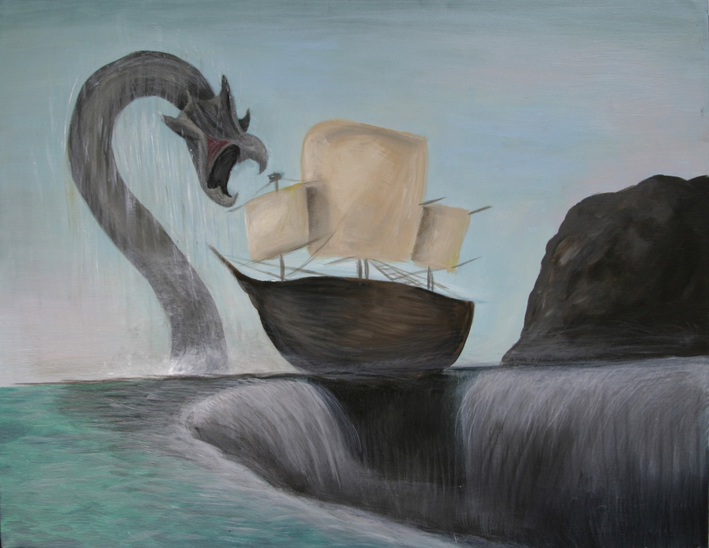
Charybdis and Scylla?
Platonism gives us good truthmakers, but sticks us with embarrassing epistemological theories
Aristotle’s views link up better with sensible ideas about how we come to know things, but seem to stick us with theories that imply that clearly true mathematical claims come out false …
Can we do better than having to say “okay, pick your poison?”

Slide 13
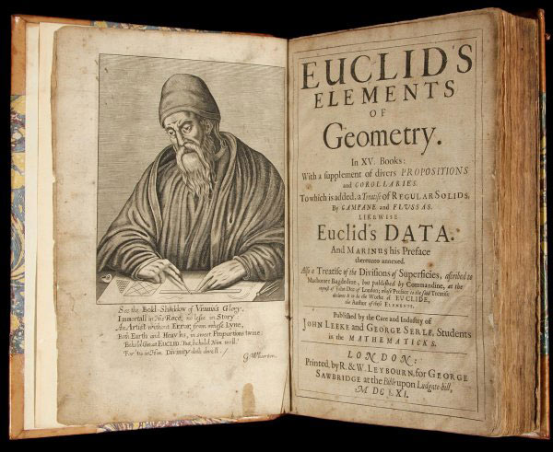
Euclid
It’s often said that there have been more editions of The Elements published than any other book in human history other than the Bible.
Not much is known about the historical person, but the main mathematical accomplishment is in the synthesizing and organizing of many proofs due to others
This book was a standard part of the education of all highly educated people in many parts of the world for many centuries

Slide 14
Postulates and Common Notions
Common notions:
Things which are equal to the same thing are also equal to one another.
If equals are added to equals, the whole are equal.
If equals be subtracted from equals, the remainders are equal.
Things which coincide with one another are equal to one another.
The whole is greater than the part.
Postulates:
A straight line segment can be drawn connecting any two points
Any straight line segment can be extended indefinitely in a straight line.
Given any straight line segment, a circle can be drawn having the segment as radius and one endpoint as center.
That all right angles are congruent.
If two lines are drawn which intersect a third in such a way that the sum of the inner angles on one side is less than two right angles, then the two lines inevitably must intersect each other on that side if extended far enough.

Slide 15
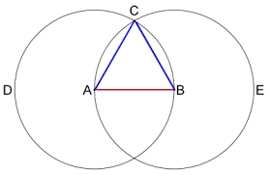
From these building blocks, we can prove theorems
Theorem 1: From a given line segment, an equilateral triangle can be produced.
The method is clear … by postulate 3, we can draw the circles centred on A and B, each with radius of length AB.
By postulate 1, we can produce the line segments from B to the intersection of the circles C, and from A to C.
The result is an equilateral triangle b/c the two new line segments are radii of circles with radius AB … by the common notions, all the sides are the same.
(Historical note: there are actually logical “gaps” in this proof …)

Slide 16
Questions from the day that are still questions today
What’s the “status” of the axioms (e.g. the common notions and postulates of Euclid)?
More on this next week, as we talk about what makes good arguments good
What is mathematics about?
What is the correct language for proofs?
Often we word proofs in ways that describe actions.
Who is supposed to be doing them? What about ones that are humanly impossible, for practical reasons?
Does this show there is something wrong with Platonism, where the objects are supposed to be timeless and unchanging (and so things nobody can produce or change)?
Are we just speaking carelessly, and all this could just be reworded (“there is a circle with radius of length AB around the point A”, and so on)?

